Slide 1

UNIT-III
Software Design

Slide 2
PART 1
1.Software Design:
Outcome of a design process,
Cohesion and Coupling
Layered arrangement of modules
Approaches to software design,
2.Function-oriented Software design:
Overview of SA/SD methodology
Structured analysis
DFDs,Structured design
Detailed design, design review
PART II
3.Object-oriented software design:
UML diagrams
Use case modeling
Unified process
OOD goodness criteria
4.User interface design:
Types of user interfaces
Component-based GUI development
5.Web Application Design.Exemplar/Case Studies:
Study design of Library management system

Slide 3








Design Fundamentals
Cohesion & Coupling
Structure & Approaches
Function-Oriented Design
Outcome of design, quality, core concepts
Classification, high-cohesion / low-coupling
Layered modules · FOD vs OOD
SA/SD, DFDs, structure charts, review
Object-Oriented Design
User Interface Design
Web Application Design
Synthesis & Review
UML, use cases, Unified Process, OOD criteria
Golden rules, UI types, component GUIs
Design pyramid, MVC, navigation
Principles cheat-sheet & takeaways
2

Slide 4

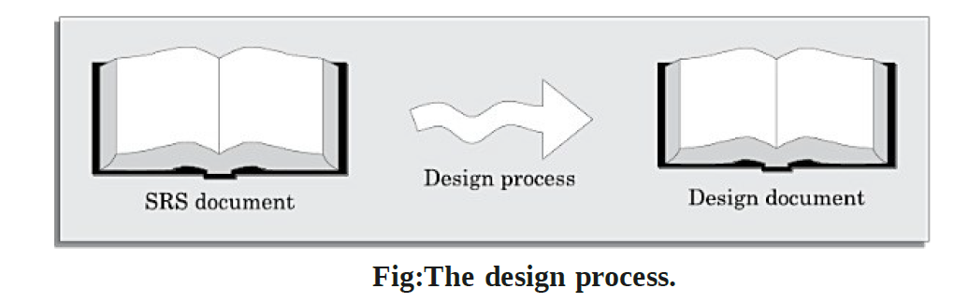
Software design deals with transforming the customer requirements, as described in the SRS document,into a form (a set of documents) that is suitable for implementation in a programming language.

Slide 5


1.What is software design?
Design bridges requirements and code
Software design is the creative process of transforming the "what" captured in the requirements (SRS) into the "how" — a blueprint precise enough to be built, tested, and maintained.
Requirements
Design
Construction
SRS · the problem
blueprint · the solution shape
code · the working system
Two levels of design
Architectural / high-level design
Detailed / low-level design
Decompose the system into modules and define their relationships & interfaces — the "top-level" structure.
Specify the internal logic, data structures and algorithms of each module so it can be coded directly.
4

Slide 6
Design Within the Context of Software Engineering
Each element of the analysis model provides information that is necessary to create the four design models
  The data/class design transforms analysis classes into design classes along with the data structures required to implement the software
  The architectural design defines the relationship between major structural elements of the software; architectural styles and design patterns help achieve the requirements defined for the system
  The interface design describes how the software communicates with systems that interoperate with it and with humans that use it.
  The component-level design transforms structural elements of the software architecture into a procedural description of software components

Slide 7
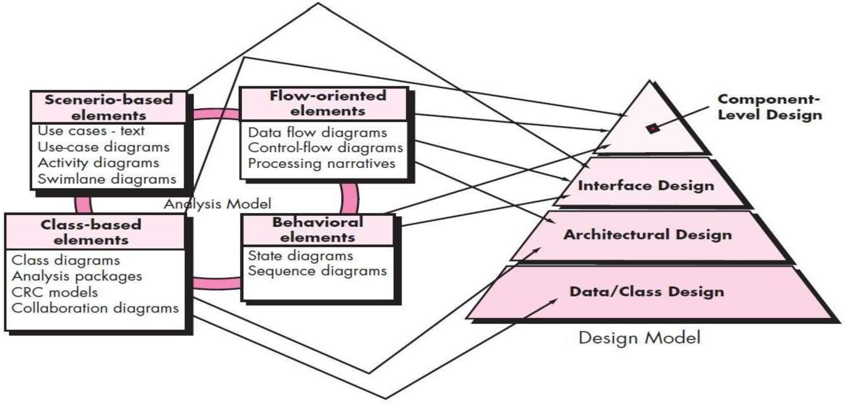
From Analysis Model to Design Model
Fig:Translating the requirements model into the design model

Slide 8


Characteristics of a good design
Correctness
Understandability rests on two pillars
Implements all of the requirements — and nothing that is not required.
Understandability
High cohesion
Uses a clean, consistent structure that another engineer can readily grasp.
Each module does one well-defined job — it is "single-minded".
Efficiency
Makes good use of computing resources (time, memory, energy).
Low coupling
Modules depend on each other as little as possible, through narrow interfaces.
Maintainability
Is easy to change, extend and repair as needs evolve.
6

Slide 9
Characteristics of Good Design
1)The design must implement all of the explicit requirements contained in the requirements model, and it must accommodate all of the implicit requirements desired by stakeholders.
2)The design must be a readable, understandable guide for those who generate code and for those who test and subsequently support the software.
3)The design should provide a complete picture of the software, addressing the data, functional, and behavioral domains from an implementation perspective.

Slide 10
Guidelines for Good Design
1)Design has been created using recognizable architectural styles or patterns
)Design is composed of components that exhibit good design characteristics
can be implemented in an evolutionary
3)A design should lead to data structures that are appropriate for the classes to be implemented and are drawn from recognizable data patterns.
4)A design should lead to components that exhibit independent functional characteristics.
5)A design should lead to interfaces that reduce the complexity of connections between components and with the external environment.
6)A design should be derived using a repeatable method that is driven by information obtained during software requirements analysis.
7)A design should be represented using a notation that effectively communicates its meaning.

Slide 11
Design Quality Attributes
FURPS functionality, usability, reliability, performance, and supportability. The FURPS quality attributes represent a target for all software design:
  Functionality is assessed by evaluating the feature set and capabilities of the program, the generality of the functions that are delivered, and the security of the overall system..
  Usability is assessed by considering human factors, overall aesthetics, consistency, and documentation.
  Reliability is evaluated by measuring the frequency and severity of failure, the accuracy of output results, the mean-time-to-failure (MTTF), the ability to recover from failure, and the predictability of the program.
  Performance is measured by considering processing speed, response time.
  Supportability combines the ability to extend the program (extensibility), adaptability, serviceability these three attributes represent a more common term, maintainability and in addition, testability, compatibility, configurability

Slide 12







DESIGN FUNDAMENTALS
Fundamental design concepts
A set of foundational ideas provides the software designer a vocabulary and a means of coping with complexity.
Abstraction
Modularity
Information hiding
Functional independence
Focus on essentials; suppress detail — procedural & data abstraction.
Divide software into named, addressable components ("divide & conquer").
Each module hides its internal decisions behind a stable interface.
Modules with single purpose and minimal interaction (cohesion + coupling).
Stepwise refinement
Architecture
Design patterns
Refactoring
Elaborate the design top-down, adding detail level by level.
The overall structure — components and how they interact.
Proven, reusable solutions to recurring design problems.
Improve internal structure without changing external behaviour.
7

Slide 13
Design Concepts
1.Abstraction
2.Modularity
3.Encapsulation
4.Functional Independence
5.Refinement
6.Refactoring
7.Architecture
8.Patterns
9.Design classes

Slide 14
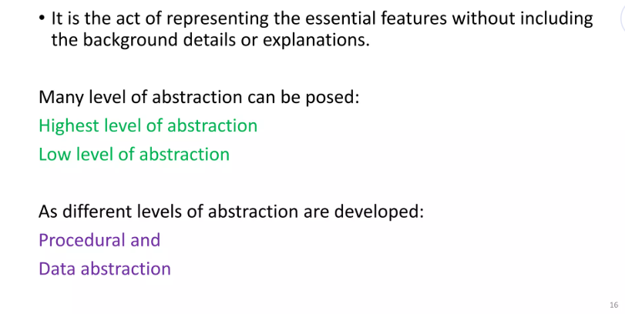
1.Abstraction

Slide 15
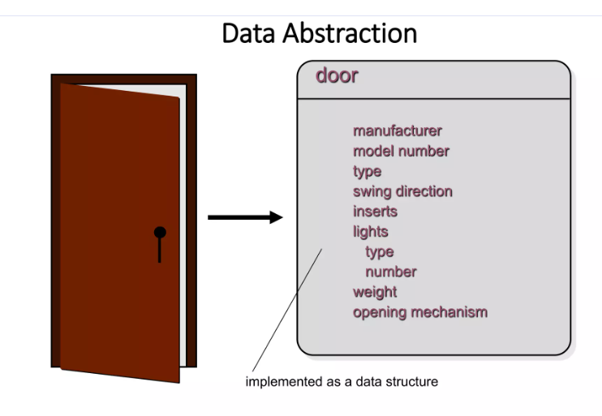
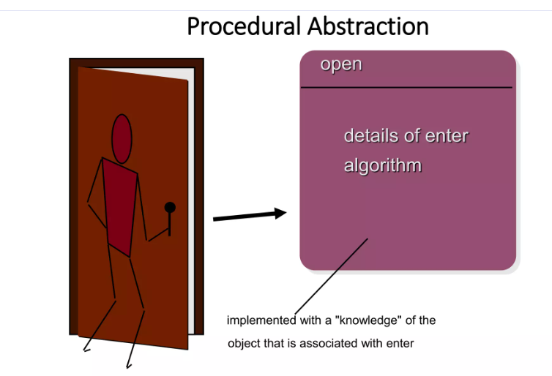

Slide 16
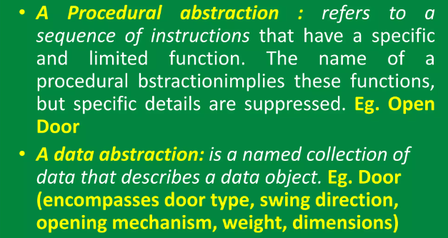

Slide 17
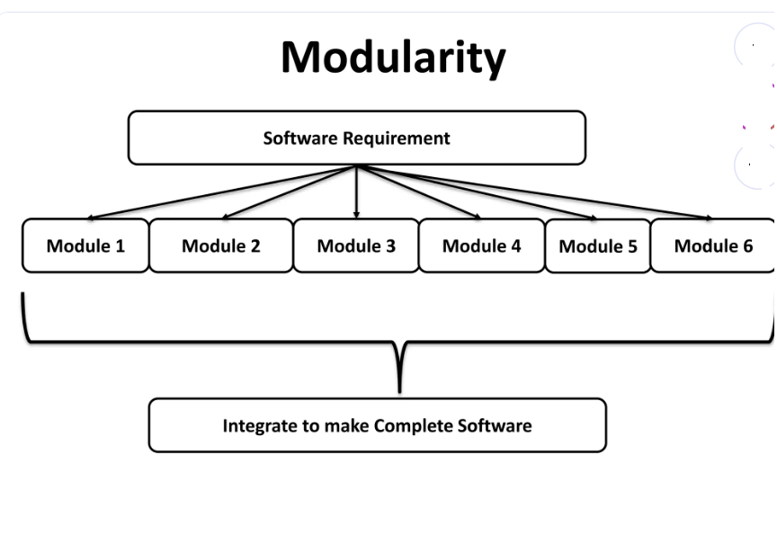
Modularization
is a software design concept to divide the software into modules, it follow “divide an conquer” strategy.
Advantage:it’s easier to solve complex problem when you break it into manageable pieces.

Slide 18
Separation of Concerns
Any complex problem can be more easily handled if it is subdivided into pieces that can each be solved and/or optimized independently
A concern is a feature or behavior that is specified as part of the requirements model for the software
By separating concerns into smaller, and therefore more manageable pieces, a problem takes less effort and time to solve.

Slide 19
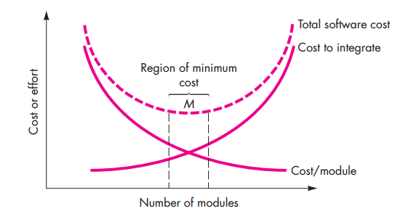

Slide 20
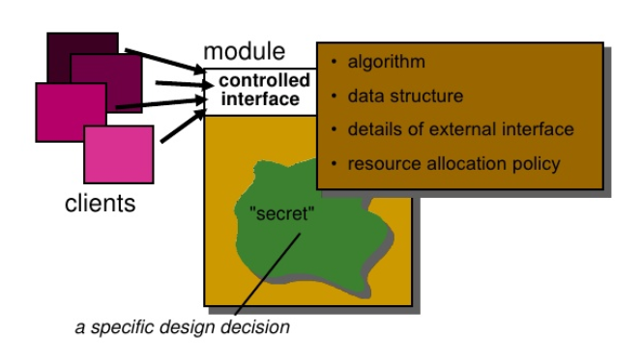
Information Hiding/Encapsulation
Modules should be specified and designed so that information (algorithms and data) contained within a module is inaccessible to other modules that have no need for such information;
Hiding defines and enforces access constraints to procedural details and local data structures used within a module.
Advantage:
  Hiding prevents error propagation outside of a module.
  Security of data,algorithm

Slide 21
Functional independence
Each module should address a specific sub function of requirements and have a simple interface.
Functional independent modules are easier to develop, maintain, and test;
Error propagation is reduced and reusable modules are possible;
Assessed using two qualitative criteria:
cohesion;
coupling.

Slide 22
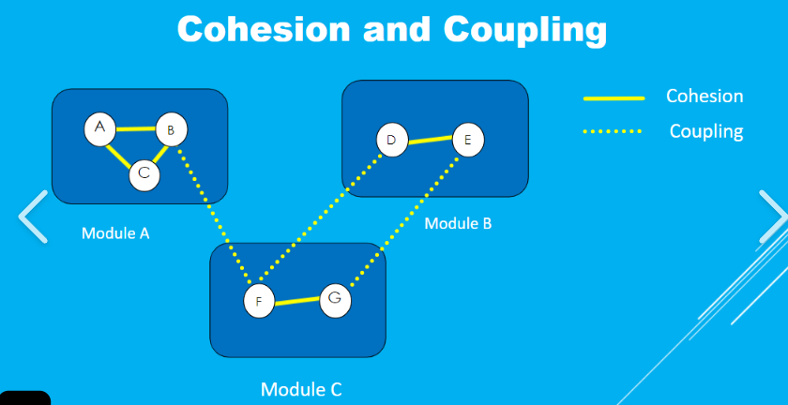
Cohesion & Coupling
Cohesion:
  It is a measure that defines the degree of intra-dependability within elements of module. The greater the cohesion, better is the program design.
  Cohesion is an intra-module dependency. During design have to increase intra-module dependency.
Coupling
  Coupling is an indication of interconnection/interdependency between modules in a structure of software.
  Coupling is an inter-Module dependency. During design have to decrease inter-module dependency.
  Example
    If two modules are strongly coupled are strongly dependent on each other.
    On the other hand, two modules that are loosely coupled are not dependent on each other.

Slide 23
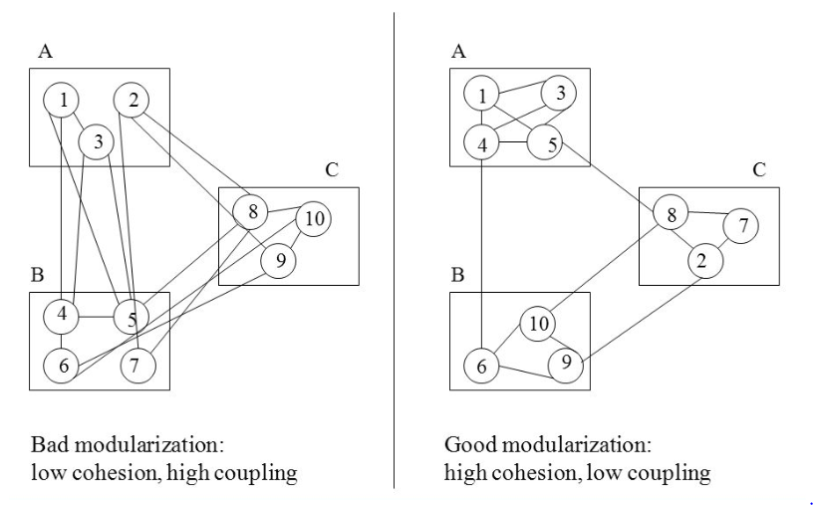
Cohesion vs Coupling

Slide 24
COHESION & COUPLING
The design goal: high cohesion, low coupling
Poor design — low cohesion, high coupling
Good design — high cohesion, low coupling
M1
M3
M1
M3
M2
M2
✕ Tangled internals, many heavy links → fragile & hard to change
✓ Focused modules, few clean links → robust & maintainable
Rule of thumb: maximise cohesion within modules, minimise coupling between them — this is the essence of functional independence.
14

Slide 25


Cohesion — the single-mindedness of a module
Cohesion measures how strongly the elements within a single module belong together.
A highly cohesive module performs one — and only one — well-defined task. Its statements, data and operations all contribute to that single purpose.
Why high cohesion helps
Symptoms of low cohesion
Easier to understand — one clear purpose per module
Easier to reuse — a focused module drops into new contexts
Easier to maintain — changes stay localised
Fewer ripple effects and side-effects when editing
A module that does "a bit of everything"
Names like process(), handleAll(), doStuff()
Elements grouped only by timing or control flags
Hard to describe what the module does in one sentence
10

Slide 26
Classification of cohesion — 7 levels
Functional
7
one problem-related task
Aim for functional cohesion
Sequential
"Find the square root", "sort the list", "compute payroll tax" — a module you can name with a single, precise verb phrase.
6
output of one part feeds the next
Communicational
5
all parts act on the same data
INCREASING COHESION → MORE DESIRABLE
Procedural
4
elements follow a control sequence
Avoid coincidental cohesion
Temporal
3
elements run at the same time (e.g. init)
A "utility" or "misc" module holding unrelated routines lumped together for no reason — the hardest kind to maintain.
Logical
2
similar-category actions, one chosen by flag
Coincidental
1
no meaningful relationship at all
11

Slide 27


COHESION & COUPLING
Coupling — interdependence between modules
Coupling measures the degree of interdependence between two modules.
The more one module must know about another's internals, the higher the coupling — and the harder it becomes to change either one in isolation.
Why low coupling helps
What raises coupling
Change a module without breaking its neighbours
Understand a module without reading the whole system
Reuse and test modules in isolation
Fewer bugs propagate across module boundaries
Sharing global data between modules
Passing control flags that steer another module's logic
One module reaching into another's internal data
Fat interfaces passing whole records for one field
12

Slide 28
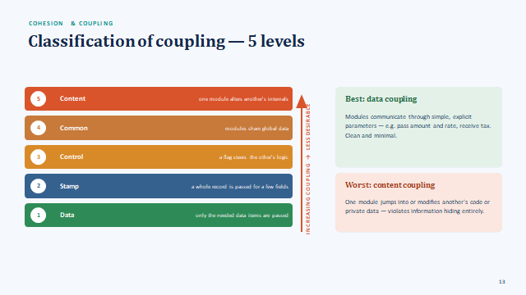

Slide 29
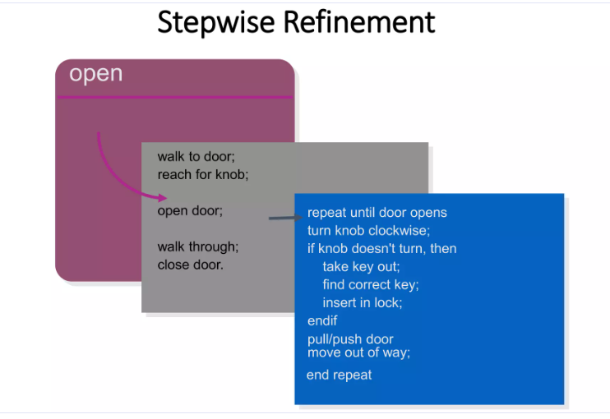
Stepwise refinement
It is a top-down design strategy originally proposed by Niklaus Wirth. Refinement is actually a process of elaboration. You begin with a statement of function that is defined at a high level of abstraction.

Slide 30
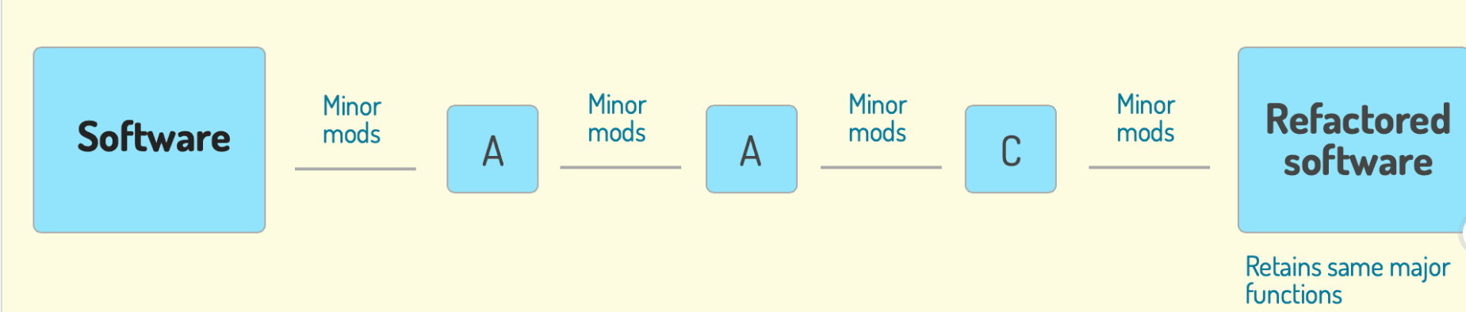
Refactoring
Refactoring is the process of changing a software system in such a way that it does not alter the external behavior of the code [design] yet improves its internal system
An important design activity suggested for many agile methods, refactoring is a reorganization technique that simplifies the design (or code) of a component without changing its function or behavior.

Slide 31
Architecture
The overall structure of the software and the ways in which the structure provides conceptual integrity for a system :
  Consists of components, connectors, and the relationship between them.
  Some of the Architecture models are described below,
  Structural models – architecture as organized collection of components
  Framework models – attempt to identify repeatable architectural patterns
  Dynamic models – indicate how program structure changes as a function of external events
  Process models – focus on the design of the business or technical process that system must accommodate
  Functional models – used to represent system functional hierarchy

Slide 32
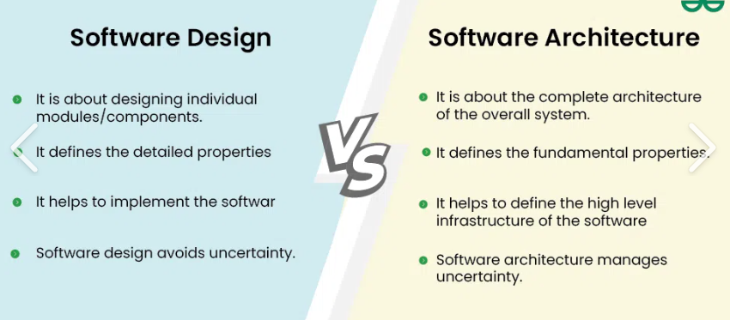

Slide 33
Patterns
Software engineer can use the design pattern during the entire software design process.
Each pattern is to provide an insight to a designer who can determine the following-:
Whether the pattern can be reused.
Whether the pattern is applicable to the current project.
Whether the pattern can be used to develop a similar but functionally or structurally different design pattern.

Slide 34
Design Classes
The requirements model defines a set of analysis classes
Set of design classes that refine the analysis classes by providing design detail that will enable the classes to be implemented, and implement a software infrastructure that supports the business solution.

Slide 35
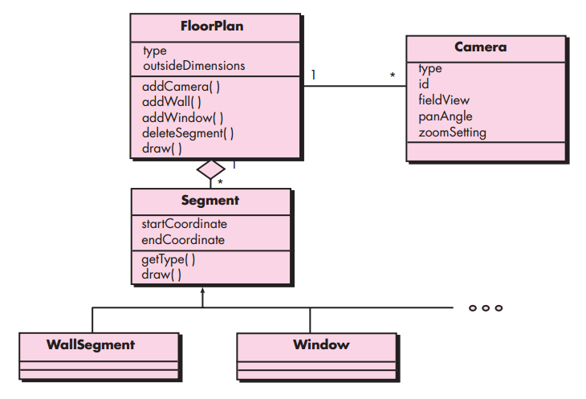
Design class for FloorPlan and composite aggregation for the class

Slide 36
Layered arrangement of modules
In a good design, modules are arranged in a hierarchy (a tree-like control structure). Higher-level modules control and invoke lower-level ones. The control hierarchy is captured in a structure chart.
Main
Structure-chart terminology
Depth
number of levels of control (tree height)
Input
Process
Output
Width
overall span of control (max modules at a level)
Fan-out
number of modules directly controlled by a module
Compute
Validate
Fan-in
number of modules that directly control a module
Superordinate
a module that controls another
Subordinate
a module controlled by another
Guideline: keep fan-out moderate (≈ 7±2) and prefer high fan-in — a sign of reusable, well-factored modules.
16

Slide 37


STRUCTURE & APPROACHES
Two approaches to software design
Function-Oriented Design
Object-Oriented Design
Decomposes the system by function
Decomposes the system by objects
the system is a set of interacting functions/processes
the system is a set of collaborating objects
Centres on data flow
Centres on data + behaviour
data moves through and is transformed by functions
objects bundle state with the operations on it
Top-down decomposition
Bottom-up + iterative
refine high-level functions into sub-functions
identify classes, then relationships & behaviour
Data & functions are separate
Encapsulation
global/shared data acted on by procedures
data hidden inside objects, exposed via methods
Methods
Methods
SA/SD, Structured Design, DFDs, structure charts
UML, use cases, Unified Process, design patterns
17

Slide 38
2.Function-Oriented Design
The SA/SD methodology — structured analysis with DFDs, structured design into structure charts, detailed design and review.

Slide 39
Function-Oriented Design — SA/SD Overview
Structured Analysis (SA) focuses on understanding the problem using data-flow-oriented models.
Structured Design (SD) converts the analysis model into a modular program structure.
Typical flow: requirements → context diagram → leveled DFDs → transform/transaction analysis → structure chart → detailed module design → review.
Primary objective: decompose a complex problem into manageable modules with controlled interfaces.
13
Source: Pressman & Maxim, 9th ed.

Slide 40
SA/SD Methodology — Conceptual Flow
Problem
Statement
Structured
Analysis
DFDs
Structured
Design
Structure
Chart
Detailed
Design
14
Pressman-aligned syllabus figure; original schematic connecting structured analysis/design concepts.

Slide 41


Overview of the SA/SD methodology
Structured Analysis / Structured Design (DeMarco, Yourdon & Constantine) turns an SRS into a detailed design through two major activities.
SRS
Structured Analysis
Structured Design
Detailed Design
Requirements specification
Model the system as a set of DFDs (functional view)
Map DFDs to a structure chart of modules
Specify each module's internal logic
Structured Analysis (SA)
Structured Design (SD)
Produces a hierarchy of Data Flow Diagrams that model WHAT the system does — its functions and the data flowing among them. Essentially functional decomposition.
Transforms the DFD model into a structure chart that shows HOW the system is organised into modules and how control passes between them.
19

Slide 42
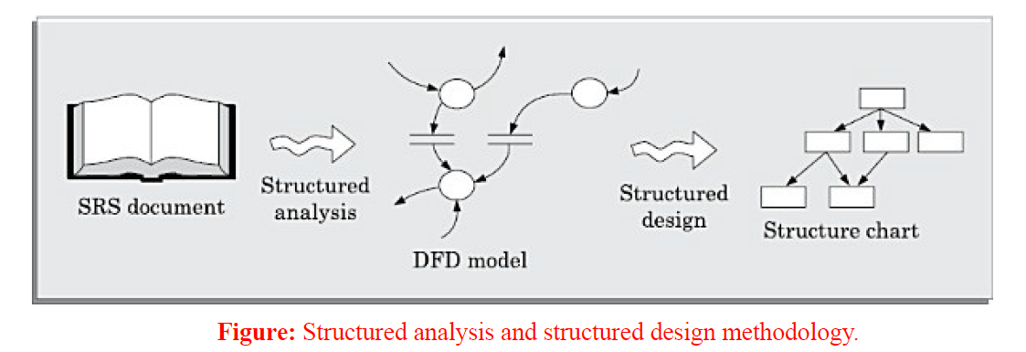

Slide 43


Structured Analysis
Core idea
Top-down decomposition
Data-flow orientation
Model the system top-down as a set of functions that transform inputs into outputs, connected by the data that flows between them. Detail is added level by level.
Start with one high-level view and progressively split each function into sub-functions.
Follow the data: what comes in, how it is transformed, what goes out.
Abstraction & leveling
Supporting artifacts
Each DFD level hides detail of the level below it (balanced across levels).
Data dictionary + process specifications (structured English, decision tables/trees).
The three products of structured analysis
Data Flow Diagrams
Data Dictionary
Process Specifications
graphical model of functions & data movement
precise definition of every data item & store
the logic of each primitive (bottom-level) process
20

Slide 44
Data Flow Diagrams — notation
A DFD is a graphical model showing how data moves through a system and is transformed by its functions. Four symbols capture everything.
User
invoice
1.0
D1
Orders
Process (bubble)
External entity
Data store
Data flow
a function that transforms data
source / sink outside the system
a repository of data at rest
movement of data (labelled arrow)
Put together:
Customer
order
1.0
Process
valid order
D1 | Orders
Each bubble must have both inputs and outputs — data cannot appear from nowhere.
21

Slide 45
Data Flow Diagram (DFD) — Basic Notation
Chapter 9 — Design Evaluation / Technical Review
External
Entity
Process
Data Store
Data Flow
DFD answers: Who provides data? What transforms it? Where is it stored? Where does it go?
16
Pressman-aligned original DFD notation slide; not a reproduction of a textbook figure.

Slide 46
DFDs are built level by level
A DFD hierarchy refines the system top-down. Each bubble on one level explodes into a whole diagram on the next — while staying balanced (inputs/outputs preserved).
Level 0 — Context diagram
Level 1 — top-level breakdown
The entire system as a single bubble, with external entities and net flows.
The single bubble becomes several numbered processes (1, 2, 3 …) with data stores between them.
0
System
1
Validate
2
Process
3
Report
User
Bank
explode
D1 | Records
One bubble · numbered 0
Deeper levels (Level 2, 3 …) refine each process further until every bottom bubble is a simple primitive described by a process specification.
22

Slide 47
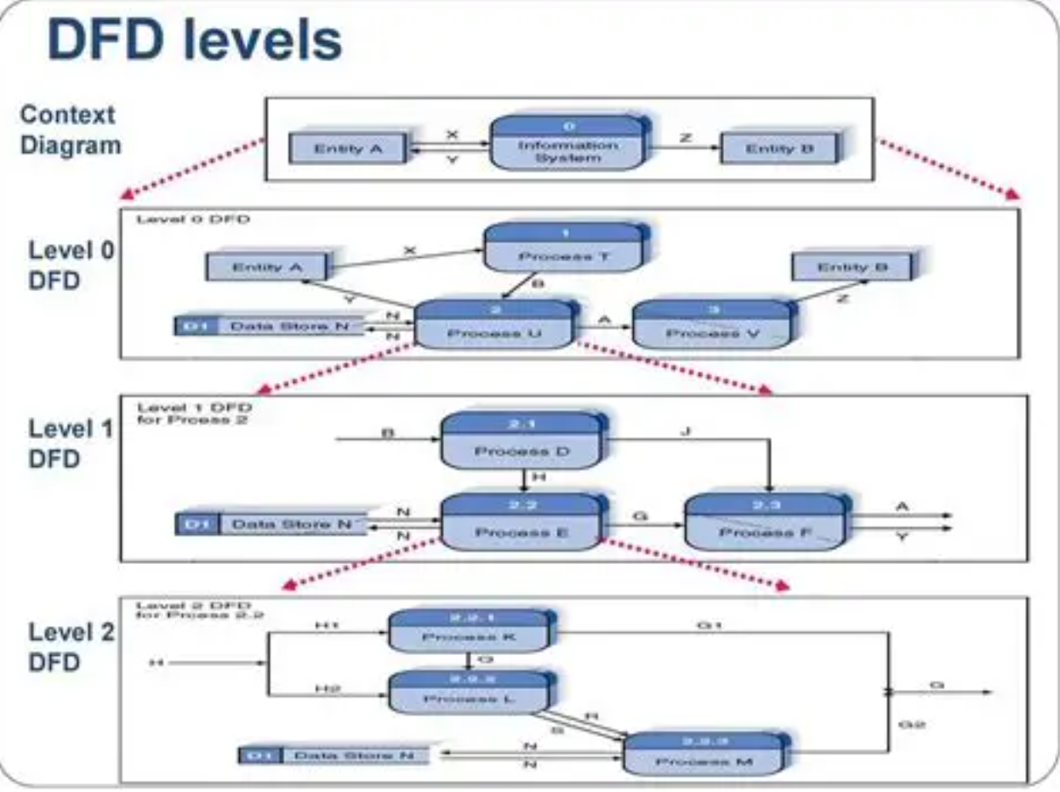

Slide 48
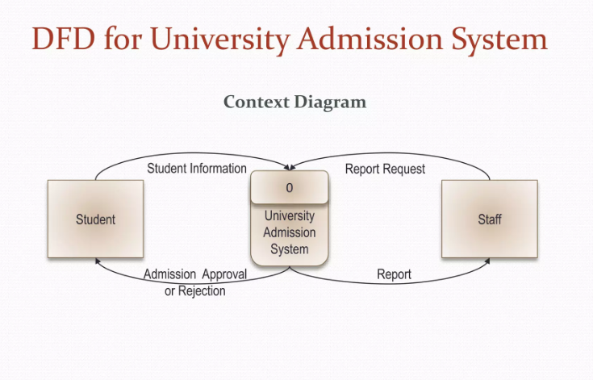

Slide 49
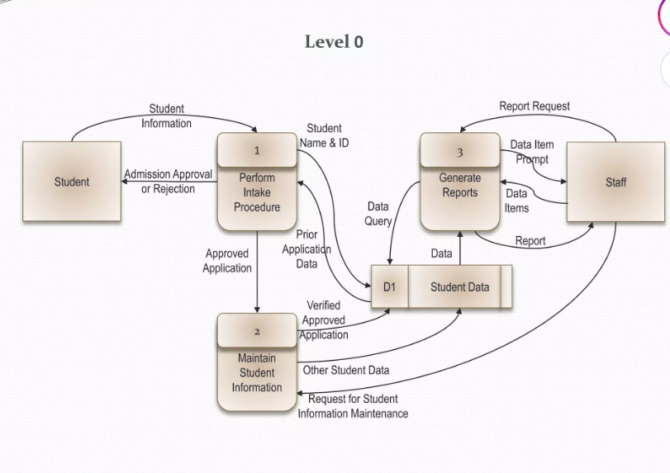

Slide 50
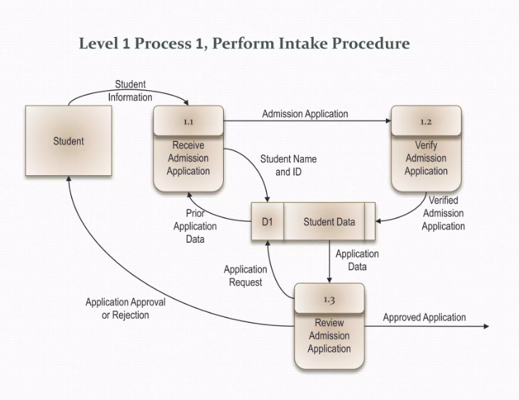

Slide 51
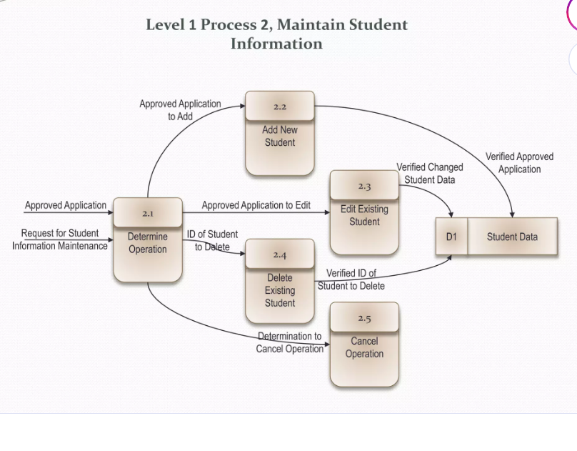

Slide 52
DFD rules & common pitfalls
Do
Don't
Every process has at least one input and one output
✕
A process with outputs but no inputs ("miracle")
Label every data flow with a meaningful noun
✕
A process with inputs but no outputs ("black hole")
Number processes for traceability across levels
✕
Data flowing directly between two data stores
Keep diagrams balanced — parent I/O = child I/O
✕
Data flowing directly between two external entities
Aim for 7±2 bubbles per diagram (avoid clutter)
✕
Showing control logic or loops — a DFD is not a flowchart
23

Slide 53

FUNCTION-ORIENTED DESIGN
Structured Design — DFD to structure chart
Structured design maps the analysis model (DFDs) onto a modular architecture (a structure chart). Two strategies decide the mapping.
Transform analysis
Transaction analysis
Used when data flows through a clear input → transform → output path. Identify the "central transform", then factor the DFD into afferent (input), transform, and efferent (output) branches under a top module.
Used when a single input triggers one of several distinct paths. A "transaction centre" dispatches to the appropriate action module based on the transaction type.
Locate incoming & outgoing flow boundaries
Identify the transaction centre (dispatcher)
Central transform becomes the main processing
Each transaction type → its own sub-tree
First-level factoring → input / transform / output
Common actions factored into shared modules
24

Slide 54
Structured Chart
Modules: These are the system components, represented as boxes. The modules are arranged from top to bottom in order of hierarchy. High-level modules are placed at the top while lower-level, more detailed modules are placed below.
Lines: Lines are used to connect the modules to show the dependencies between them. Control flows downwards through the structure chart.
Control: The lines indicate the control relationships between modules. A control relation means one module invokes or calls the other module below it.

Slide 55
FUNCTION-ORIENTED DESIGN
The structure chart
A structure chart is the primary output of structured design: a tree of modules showing the call hierarchy and the data / control couples passed between them.
Process Payroll
Couples
data couple
control flag
Get Employee
Compute Pay
Print Cheque
Arrows show which module calls which; annotations show what data passes.
Read Record
Validate
Calc Tax
Read the chart top-down: the root controls the flow; leaves do the primitive work. Same terminology as the layered arrangement — depth, width, fan-in, fan-out.
25

Slide 56
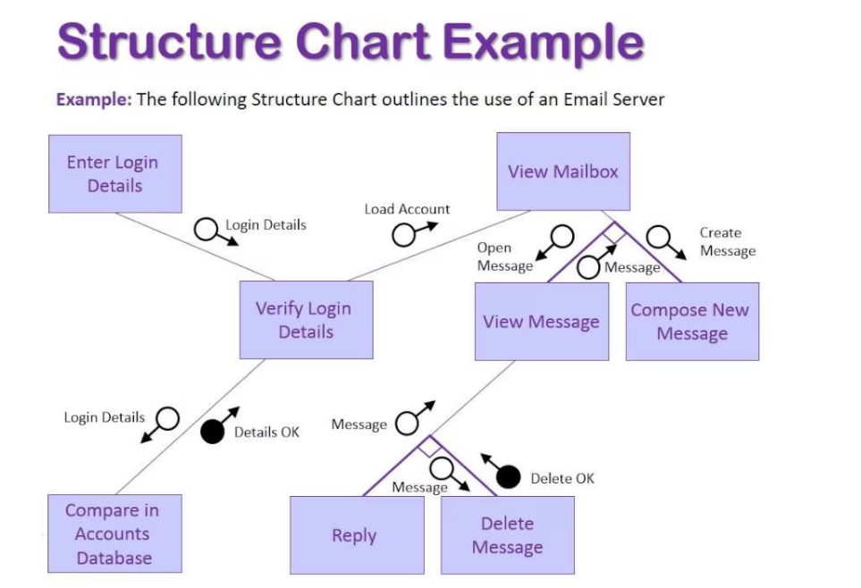

Slide 57
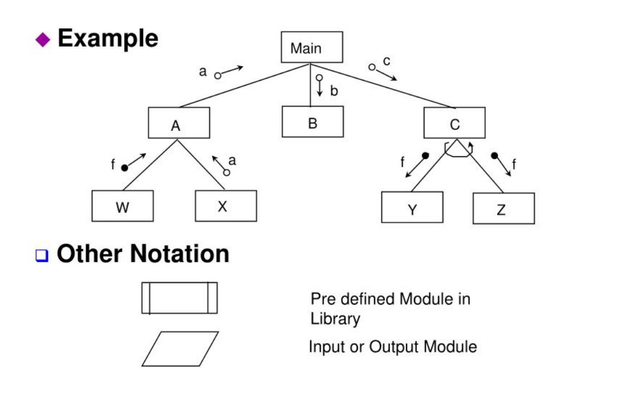

Slide 58
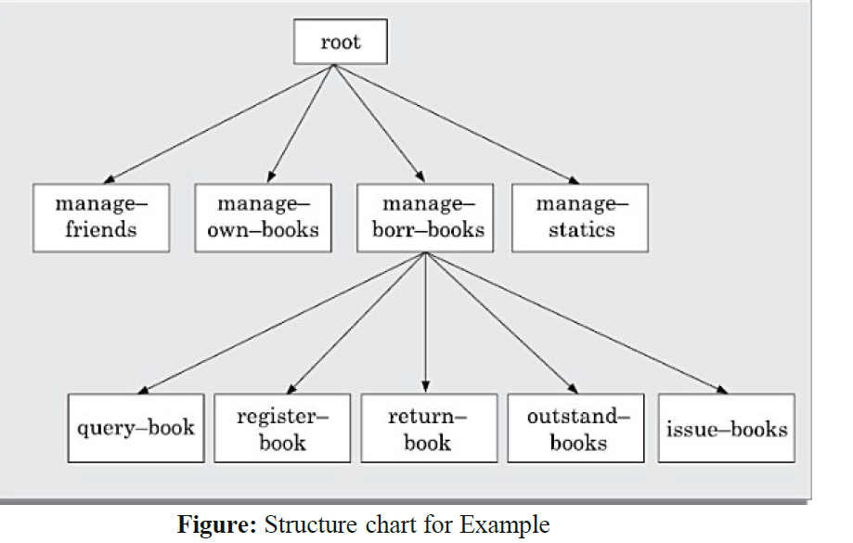

Slide 59

FUNCTION-ORIENTED DESIGN
Detailed design
Once the structure chart fixes the modules, detailed (procedural) design specifies the internal logic and data structures of each module — precisely enough to code from.
Structured English
Decision tables
Pseudocode using a limited vocabulary of sequence, selection and iteration — readable yet unambiguous.
Tabulate combinations of conditions against the actions to take — ideal for complex business rules.
Decision trees
Flowcharts / activity
A branching view of the same conditions/actions — easier to read for a small number of rules.
Graphical control-flow of the algorithm; UML activity diagrams serve the same purpose today.
Also specified here
Data structures for each module · algorithms with their complexity · error & exception handling · module interface details (exact parameters, types, pre/post-conditions).
26

Slide 60
During detailed design
The pseudo code description of the processing and the different data structures
are designed for the different modules of the structure chart.
These are usually described in the form of module specifications (MSPEC). MSPEC is usually written using structured English.
The MSPEC for the non-leaf modules describe the different conditions under which the responsibilities are delegated to the lower- level modules.
The MSPEC for the leaf-level modules should describe in algorithmic form how the primitive processing steps are carried out.
To develop the MSPEC of a module, it is usually necessary to refer to the DFD model and the SRS document to determine the unctionality of the module.

Slide 61



FUNCTION-ORIENTED DESIGN
Design review
Why review the design?
Walkthrough
Author leads peers through the design informally to surface issues.
Defects removed at design cost a fraction of those found in code or in the field. A review verifies the design against the requirements before construction begins.
Formal / technical review
A structured meeting with defined roles (moderator, reader, recorder) & a checklist.
Inspection
A design-review checklist asks…
A rigorous, metric-driven examination against explicit entry/exit criteria.
Does the design implement every requirement?
Is each module highly cohesive and loosely coupled?
Are interfaces simple, consistent and well-defined?
Are data structures and algorithms appropriate?
Is the design traceable back to the analysis model?
Has error handling and boundary behaviour been addressed?
27

Slide 62
Contd…Design review
After a design is complete, the design is required to be reviewed. The review team usually consists of members with design, implementation, testing, and maintenance perspectives, who may or may not be the members of the development team.
Normally, members of the team who would code the design, and test the code, the analysts, and the maintainers attend the review meeting. The review team checks the design documents especially for the following aspects:
Traceability: Whether each bubble of the DFD can be traced to some module in the structure chart and vice versa.
They check whether each functional requirement in the SRS document can be traced to some bubble in the DFD model and vice versa.
Correctness: Whether all the algorithms and data structures of the detailed design are correct.
Maintainability: Whether the design can be easily maintained in future.
Implementation: Whether the design can be easily and efficiently be implemented.

Slide 63


